Slide 1
Chapter 13: Functions
2023

Slide 2
Chapter 13: functions
Contents:
Index
Create/drop index
Date functions

Slide 3
Index
Indexes are used to speed up the database's search operations:
By indexing the columns that are frequently used in search operations, the database can quickly locate the required data.
Indexes can improve performance but can also impact data modification operations:
While indexes can significantly improve query performance, they can also slow down data modification operations such as INSERT, UPDATE, and DELETE. This is because indexes must be updated whenever the underlying data changes.
Notes:
Note: Updating a table with indexes takes more time than updating a table without (because the indexes also need an update).
It will however allow you to search faster
So only create indexes on columns that will be frequently searched against.

Slide 4
Create Index
CREATE INDEX index_name ON table_name (column1, column2 ...);
CREATE INDEX ix_customers_name
ON sales.customers(last_name, first_name);
Notes:
Note: Updating a table with indexes takes more time than updating a table without (because the indexes also need an update). It will however allow you to search faster
So only create indexes on columns that will be frequently searched against.

Slide 5
Drop index
SQL Server
DROP INDEX index_name ON table_name;
MySQL
ALTER TABLE table_name DROP INDEX index_name;
Notes:
delete an index in a table

Slide 6
Date functions
Function | Description
CURDATE | Returns the current date.
DATEDIFF | Calculates the number of days between two DATE values.
DAY | Gets the day of the month of a specified date.
DATE_ADD | Adds a time value to date value.
DATE_SUB | Subtracts a time value from a date value.
DATE_FORMAT | Formats a date value based on a specified date format.
DAYNAME | Gets the name of a weekday for a specified date.
DAYOFWEEK | Returns the weekday index for a date.
EXTRACT | Extracts a part of a date.

Slide 7
Function | Description
LAST_DAY | Returns the last day of the month of a specified date
NOW | Returns the current date and time at which the statement executed.
MONTH | Returns an integer that represents a month of a specified date.
STR_TO_DATE | Converts a string into a date and time value based on a specified format.
SYSDATE | Returns the current date.
TIMEDIFF | Calculates the difference between two TIME or DATETIME values.
TIMESTAMPDIFF | Calculates the difference between two DATE or DATETIME values.
WEEK | Returns a week number of a date.
WEEKDAY | Returns a weekday index for a date.
YEAR | Return the year for a specified date

Slide 8
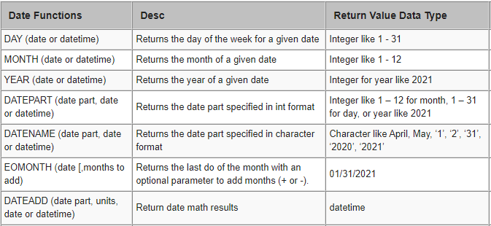
Date Functions

Slide 9
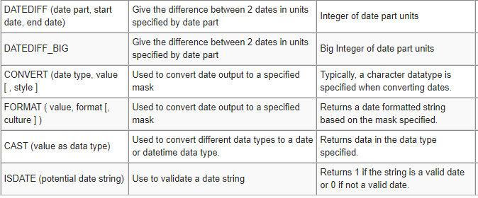
Date functions
Notes:
Datediff_big?

Slide 10
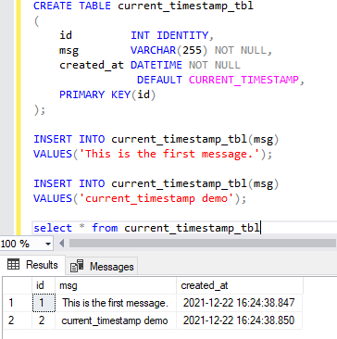
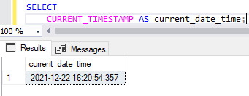
Date functions: CURRENT_TIMESTAMP
The CURRENT_TIMESTAMP function returns the current timestamp of the operating system of the server on which the SQL Server Database runs.
The CURRENT_TIMESTAMP function takes no argument
The values in the [created_at] column took the timestamp returned by the CURRENT_TIMESTAMP function of when the values were created.

Slide 11
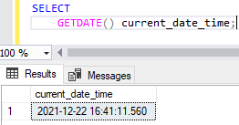
GETDATE()
The GETDATE() function returns the current system timestamp as a DATETIME value without the database time zone offset.
The DATETIME value is derived from the Operating System (OS) of the server on which the instance of SQL Server is running.
Notes:
MySQL – Curdate

Slide 12
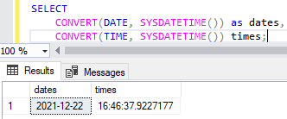
SYSDATETIME()
The SYSDATETIME() function returns a value of DATETIME2 that represents the current system date and time of the server on which the SQL Server instance is running.
Notes:
Mysql - sysdate

Slide 13
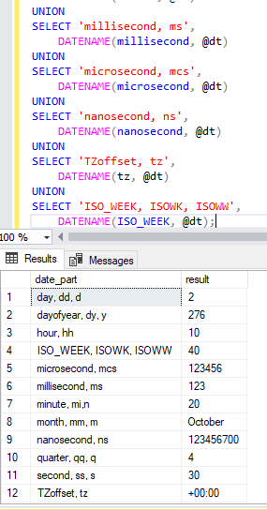
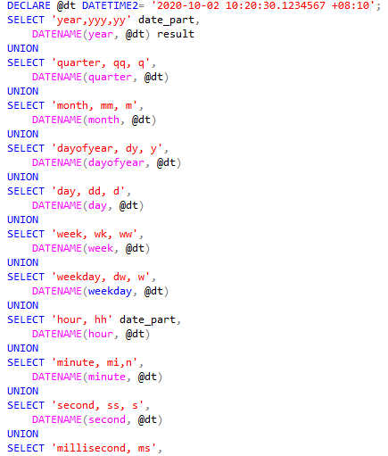

DATENAME()
The DATENAME() characteristic returns a string NVARCHAR type that represents a particular date component e.g. Seconds, nanoseconds, year, month and day of a particular date etc.
Notes:
mySQL - Date_format (date, interval)

Slide 14
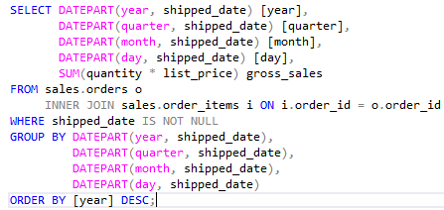
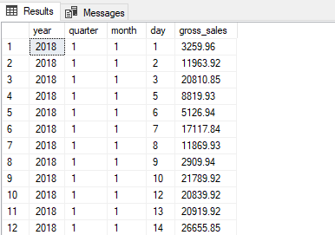
DATEPART ()
The DATEPART () function returns an integer that is part of a date. E.g. Day, month , year.
Notes:
In this example uses the DATEPART() function to query the gross sales by year quarter month and day.
We used the DATEPART() function to extract year quarter month and day from the values in the shipped_date column. In the GROUP BY clause we aggregated the gross sales ( quantity * list_price) by these date parts.
Note that you can use the DATEPART() function in the SELECT WHERE HAVING GROUP BY and ORDER BY clauses.

Slide 15
DATENAME and DATEPART are SQL Server functions that return the same information but in a different format.
The DATENAME function will return the character string-based date and time of a specified date whereas the DATEPART function will return an integer-based date and time of a specified date.

Slide 16
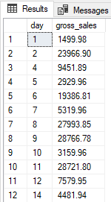
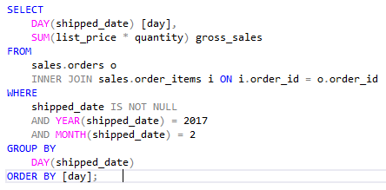
DAY()
The DAY() function returns an integer value which represents the day of a month (1-31) of a specified date.
Notes:
This example uses the DAY() function to extract the day data from the values in the shipped_date column. It returns the gross sales by day in February 2017 using the SUM() function and GROUP BY clause.

Slide 17
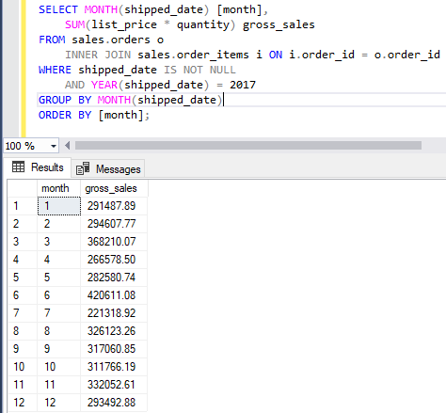
Month()
The MONTH() function returns an integer value which represents the month of a specified date. The following shows the syntax of the MONTH() function:
Notes:
This example uses the MONTH () function to extract monthly data from the values ​​in the "shipped_date" column. Use the SUM () function and the GROUP BY clause to return the total monthly sales for 2018.
Sql server returns a month name, and mysql returns a month nr

Slide 18
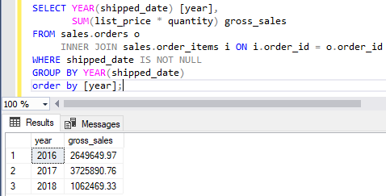
YEAR()
The YEAR() function returns an integer value which represents the year of the specified date.
Notes:
This example uses the YEAR () function to extract annual data from the values ​​in the shipped_date column. Use the SUM () function and the GROUP BY clause to return the total sales for each year.

Slide 19
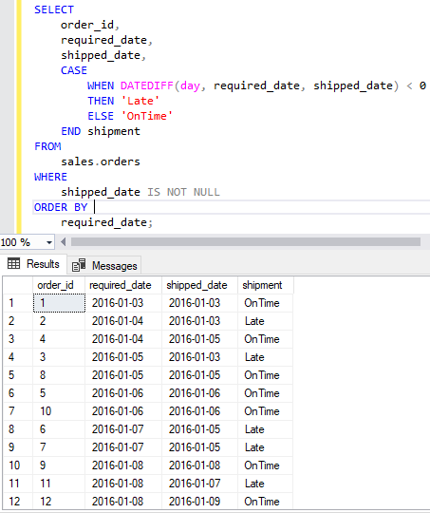
DATEDIFF ()
The DATEDIFF() function returns a value of integer indicating the difference between the start_date and end_date with the unit specified by date_part
DATEDIFF(interval, date1, date2)
Datediff(interval, old date, new date)
Datediff(y, 2000/01/01, getdate())
Notes:
The following example uses the DATEDIFF () function to compare the requested delivery date to the shipping date by days and return the order if it is on time or late.
Datediff(interval, old date, new date)
Datediff(year, ‘old date’, ‘new date’)
MySQL – will only do days by default (Timestampdiff is alternative)

Slide 20
Interval → Can be one of the following values:
year, yyyy, yy = Year
quarter, qq, q = Quarter
month, mm, m = month
dayofyear = Day of the year
day, dy, y = Day
week, ww, wk = Week
weekday, dw, w = Weekday
hour, hh = hour
minute, mi, n = Minute
second, ss, s = Second
millisecond, ms = Millisecond

Slide 21
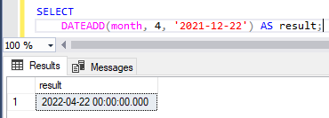
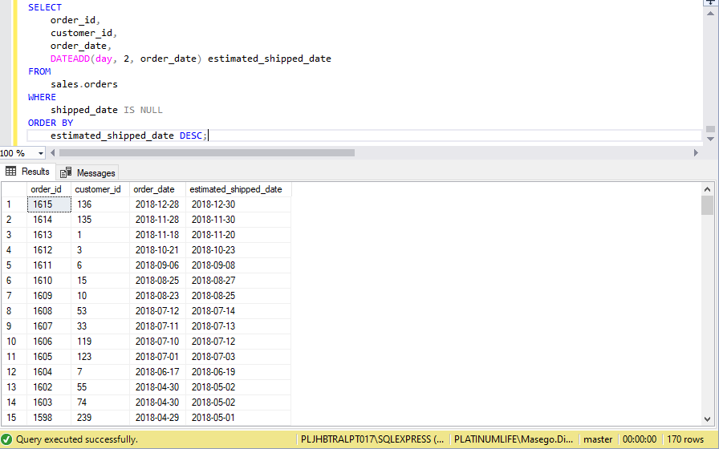
DATEADD()
The DATEADD() function adds a number to a specified date part of an input date and returns the modified value.
If the number is a decimal or a floating-point number, the DATEADD () function truncates the decimal.
DATEADD(interval, number, date)
Notes:
This example uses the DATEADD() function to calculate the estimated shipped date based on the ordered date by adding 2 days.
MySQL –
DATE_ADD(date, INTERVAL value addunit)
SELECT DATE_ADD("2017-06-15", INTERVAL 10 DAY);

Slide 22
EOMONTH ()
The EOMONTH () function returns the last day of the specified date using an optional offset.
The EOMONTH () function accepts two arguments.
1. The start_date is a date expression that is evaluated for a date. The EOMONTH () function returns the last day of the date.
2. The offset is an integer that indicates the number of months to add to start_date.
If adding offset and start_date results in an invalid date, the EOMONTH () function returns an error.
The syntax: EOMONTH(start_date, [offset] );

Slide 23
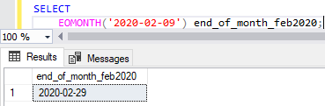
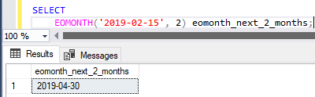
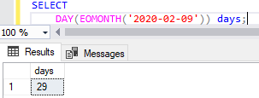
EOMONTH () Examples
2. EOMONTH() function with an offset of 2 months:
3. To get the number of days in the specified month of the date:
Notes:
1 – end of month of the date mentioned in the function
mySQL – last_day
– an offset is not allowed

Slide 24
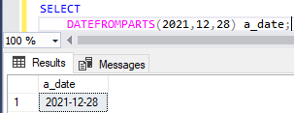
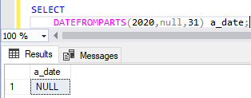
DATEFROMPARTS()
The DATEFROMPARTS() function returns a DATE value that maps to a year, month and day values.
The syntax: DATEFROMPARTS(year, month, day)
Notes:
Year - Required. Specifies a year (4 digits)
Month - Required. Specifies a month (from 1 to 12)
Day - Required. Specifies a day (from 1 to 31)

Slide 25
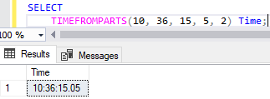
TIMEFROMPARTS()
The TIMEFROMPARTS() function returns a fully initialized time value.
The syntax: TIMEFROMPARTS ( hour minute seconds fractions precision )
In this example when the fractions has a value of 5 and precision has a value of 2 then the value of fractions represents 5/100 or 0.05 of a second.

Slide 26
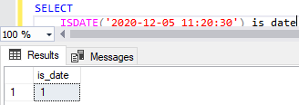
ISDATE()
The ISDATE() function accepts an argument and returns 1 if that argument is a valid DATE, TIME or DATETIME value; otherwise it returns 0.
The syntax: ISDATE(expression)

Slide 27
Date functions
How long have each employee been working for the company?
On which date would we celebrate the “30 year anniversary” of each employee
How many employees have been hired in each year?
If they all get their first salary the last day of the month after they’ve been hired, which day would they have received their first pay-check?
Plat Company
Notes:
datediff(hire date,date)
Dateadd() hire date+30 years
Year(hire date) count(*), group by year
Eomonth(hiredate)

Slide 28
Date functions
How many days did it take for customer 103 to make payment for his product with the order number 10123
Determine the customers who received their orders earlier than the required date. (HINT: The customers are considered to have received the product earlier if the product was shipped 7 days before the required date and the status must be shipped.)
Determine all the customers who received their product later than the required date.
Bonus question: Now write a query to categorize the payment received as “early” or “late”. The payment is made early if the number of days is before 7 days the order date otherwise the payment is.
L&D SHOP
Notes:
1. select o.orderNumber,o.orderdate,p.paymentdate,p.customerNumber, DATEDIFF(day,o.orderdate,p.paymentdate) from orders o
join payments p on o.orderNumber=p.orderNumber
where o.orderNumber=10123 and p.customerNumber=103
2. select c.customerNumber,o.orderNumber,c.customerName,o.shippedDate, o.requiredDate from orders o
join Customers c on o.customerNumber=c.customerNumber
where datediff(day,shippedDate,requiredDate)>7
3. select c.customerNumber,o.orderNumber,c.customerName,o.shippedDate, o.requiredDate
from orders o
join Customers c on o.customerNumber=c.customerNumber
where o.shippedDate>o.requiredDate
4. select c.customerNumber,o.orderNumber,c.customerName,o.shippedDate, o.requiredDate ,
case when datediff(day,shippedDate,requiredDate)>7 then 'early'
when o.shippedDate>o.requiredDate then 'late'
else 'Invalid'
end status
from orders o
join Customers c on o.customerNumber=c.customerNumber
order by status

